Slide 1
Induction of Decision Trees
J. Ross Quinlan
Presentation by: Ashwin Kumar Kayyoor

Slide 2
Outline
What is a decision tree?
Building a decision tree
Which attribute should we split on?
Information theory and the splitting criterion
ID3 example
ID3 enhancements: windowing
Dealing with noisy data - expected error pruning

Slide 3
Decision Trees
Each branch node represents a choice between a number of alternatives.
Each leaf node represents a classification or decision.
  For example: we might have a decision tree to help a financial institution decide whether a person should be offered a loan:

Slide 4
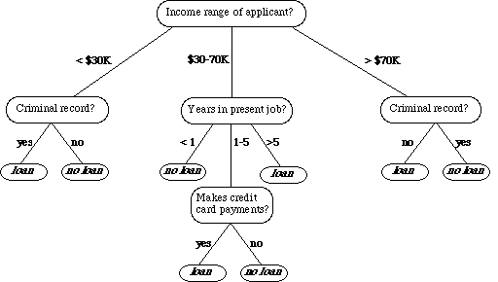

Slide 5
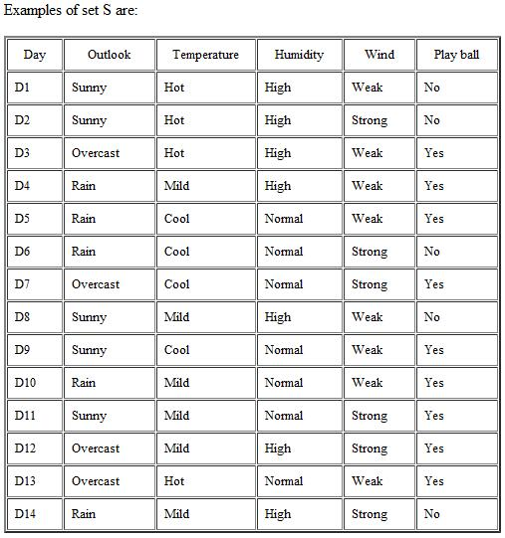
Example Instance Data

Slide 6
We shall now describe an algorithm for inducing a decision tree from such a collection of classified instances.
Originally termed CLS (Concept Learning System) it has been successively enhanced.
At the highest level of enhancement that we shall describe, the system is known as ID3 (Iterative Dichotomizer)

Slide 7
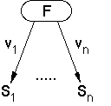
Tree Induction Algorithm
The algorithm operates over a set of training instances, C.
If all instances in C are in class P, create a node P and stop, otherwise select a feature or attribute F and create a decision node.
Partition the training instances in C into subsets according to the values of V.
Apply the algorithm recursively to each of the subsets C.

Slide 8
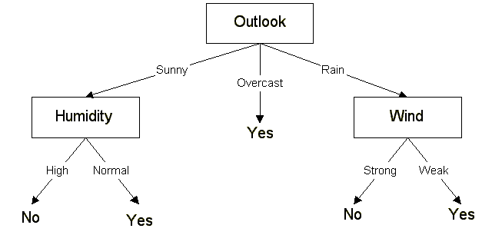
Output of Tree Induction Algorithm
if (Outlook == Overcast)
return Yes;
Else if (Outlook == Sunny)
{
if (Humidity == High)
return No;
if (Humidity == Normal)
return Yes;
}
Else if (Outlook == Rain)
{
if (Wind == Strong)
return No;
if (Wind == Weak)
return Yes;
}

Slide 9
Choosing Attributes and ID3
The order in which attributes are chosen determines how complicated the tree is.
ID3 uses information theory to determine the most informative attribute.
A measure of the information content of a message is the inverse of the probability of receiving the message:
information1(M) = 1/probability(M)
Taking logs (base 2) makes information correspond to the number of bits required to encode a message:
information(M) = -log₂(probability(M))

Slide 10
Information
The information content of a message should be related to the degree of surprise in receiving the message.
Messages with a high probability of arrival are not as informative as messages with low probability.
Learning aims to predict accurately, i.e. reduce surprise.

Slide 11
Entropy
Different messages have different probabilities of arrival.
Overall level of uncertainty (termed entropy) is:
-Σ_{i} P_{i} log₂P_{i}
Frequency can be used as a probability estimate.
E.g. if there are 5 positive examples and 3 negative examples in a node the estimated probability of positive is 5/8 = 0.625.

Slide 12
Information and Learning
We can think of learning as building many-to-one mappings between input and output.
Learning tries to reduce the information content of the inputs by mapping them to fewer outputs.
Hence we try to minimise entropy.
The simplest mapping is to map everything to one output.
We seek a trade-off between accuracy and simplicity.

Slide 13
Splitting Criterion
Work out entropy based on distribution of classes.
Trying splitting on each attribute.
Work out expected information gain for each attribute.
Choose best attribute.

Slide 14
Information Gain
Gain(S, A) is information gain of example set S on attribute A is defined as
Gain(S, A) = Entropy(S) - S ((|S_{v}| / |S|) * Entropy(S_{v}))
  Where:
  S is each value v of all possible values of attribute A
  S_{v} = subset of S for which attribute A has value v
  |S_{v}| = number of elements in S_{v}
  |S| = number of elements in S

Slide 15
Example Instance Data

Slide 16
Example
If S is a collection of 14 examples with 9 YES and 5 NO examples then
Entropy(S) = - (9/14) Log2 (9/14) - (5/14) Log2 (5/14) = 0.940
Notice entropy is 0 if all members of S belong to the same class (the data is perfectly classified). The range of entropy is 0 ("perfectly classified") to 1 ("totally random").

Slide 17
Example
For attribute Wind, suppose there are 8 occurrences of Wind = Weak and 6 occurrences of Wind = Strong
Gain(S,Wind) = Entropy(S)-(8/14)*Entropy(S_{weak})-(6/14)*Entropy(S_{strong})
  = 0.940 - (8/14)*0.811 - (6/14)*1.00
  = 0.048
Entropy(S_{weak}) = - (6/8)*log2(6/8) - (2/8)*log2(2/8) = 0.811
Entropy(S_{strong}) = - (3/6)*log2(3/6) - (3/6)*log2(3/6) = 1.00
For each attribute, the gain is calculated and the highest gain is used in the decision node.

Slide 18
Example
We need to find which attribute will be the root node in our decision tree. The gain is calculated for all four attributes:
Gain(S, Outlook) = 0.246
Gain(S, Temperature) = 0.029
Gain(S, Humidity) = 0.151
Gain(S, Wind) = 0.048 (calculated in example 2)
Outlook attribute has the highest gain, therefore it is used as the decision attribute in the root node.

Slide 19
Output of Tree Induction Algorithm

Slide 20
Example
what attribute should be tested at the Sunny branch node?
S_{sunny} = {D1, D2, D8, D9, D11} = 5 examples from table 1 with outlook = sunny
Gain(S_{sunny}, Humidity) = 0.970
Gain(S_{sunny}, Temperature) = 0.570
Gain(S_{sunny}, Wind) = 0.019
Humidity has the highest gain; therefore, it is used as the decision node. Repeat this process until all attributes are exausted.

Slide 21
Output of Tree Induction Algorithm

Slide 22
Windowing
D3 can deal with very large data sets by performing induction on subsets or windows onto the data.
  Select a random subset of the whole set of training instances.
  Use the induction algorithm to form a rule to explain the current window.
  Scan through all of the training instances looking for exceptions to the rule.
  Add the exceptions to the window
Repeat steps 2 to 4 until there are no exceptions left.

Slide 23
Noisy Data
Frequently, training data contains "noise" - i.e. examples which are misclassified, or where one or more of the attribute values is wrong.
If there are any unused attributes, we might be able to use them to elaborate the tree to take care of this one case, but the subtree we would be building would in fact be wrong, and would likely misclassify real data.
Thus, particularly if we know there is noise in the training data, it may be wise to "prune" the decision tree to remove nodes which, statistically speaking, seem likely to arise from noise in the training data.
A question to consider: How fiercely should we prune?

Slide 24
Expected Error Pruning
Approximate expected error assuming that we prune at a particular node.
Approximate backed-up error from children assuming we did not prune.
If expected error is less than backed-up error, prune.

Slide 25
(Static) Expected Error
If we prune a node, it becomes a leaf labelled, C.
What will be the expected classification error at this leaf?
E(S) = (N – n + k – 1) / (N + k)
  S is the set of examples in a node
  K is the number of classes
  N examples in S
  C is the majority class in S
  n out of N examples in S belong to C

Slide 26
Backed-up Error
For a non-leaf node
Let children of Node be Node1, Node2, etc
BackedUpError(Node) = Σ_{i} P_{i}×Error(Node_{i})
Probabilities can be estimated by relative frequencies of attribute values in sets of examples that fall into child nodes.
Error(Node) = min(E(Node), BackedUpError(Node))

Slide 27
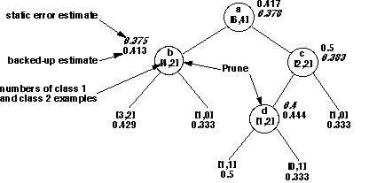
Pruning Example

Slide 28
Summary
The ID3 family of decision tree induction algorithms use information theory to decide which attribute shared by a collection of instances to split the data on next.
Attributes are chosen repeatedly in this way until a complete decision tree that classifies every input is obtained. If the data is noisy, some of the original instances may be misclassified.
It may be possible to prune the decision tree in order to reduce classification errors in the presence of noisy data.
The speed of this learning algorithm is reasonably high, as is the speed of the resulting decision tree classification system.
Generalisation ability can be reasonable too.

Slide 29
References
Quinlan, J.R. (1993). C4.5: Programs for Machine Learning. Morgan Kaufmann . (http://www.rulequest.com/Personal/)
Bil Wilson http://www.cse.unsw.edu.au/~billw/cs9414/notes/ml/06prop/id3/id3.html

